Slide 1
Blacktown Chinese Christian Church
Welcome to Our English Service 13.04.2025
English Service 9:45 – 11:00 am
Worship Songs: Passage: Speaker: Topic: Response Song: Announcements and Closing Prayer Benediction
10000 Reasons Lighthouse Start A Fire Joshua 2 TBA TBA TBA

Slide 2
BCCC english service

Slide 3

Please keep all phones on silent

Slide 4
10000 Reasons (Bless The Lord)
Jonas Myrin, Matt Redman © 2012 2011 Atlas Mountain Songs (Admin. by SHOUT! Music Publishing Australia) CCLI Licence No. 5485849 . CCLI Song number: 6016351

Slide 5
Chorus
Bless the Lord oh my soul
Oh my soul
Worship His Holy name

Slide 6
Chorus
Sing like never before
Oh my soul
I'll worship Your Holy name

Slide 7
Verse 1
The sun comes up
It's a new day dawning
It's time to sing Your song again

Slide 8
Verse 1
Whatever may pass
And whatever lies before me
Let me be singing
When the evening comes

Slide 9
Chorus
Bless the Lord oh my soul
Oh my soul
Worship His Holy name

Slide 10
Chorus
Sing like never before
Oh my soul
I'll worship Your Holy name

Slide 11
Verse 2
You're rich in love
And You're slow to anger
Your name is great
And Your heart is kind

Slide 12
Verse 2
For all Your goodness
I will keep on singing
Ten thousand reasons
For my heart to find

Slide 13
Chorus
Bless the Lord oh my soul
Oh my soul
Worship His Holy name

Slide 14
Chorus
Sing like never before
Oh my soul
I'll worship Your Holy name

Slide 15
Verse 3
And on that day
When my strength is failing
The end draws near
And my time has come

Slide 16
Verse 3
Still my soul will
Sing Your praise unending

Slide 17
Verse 3
Ten thousand years
And then forevermore
Forevermore

Slide 18
Chorus
Bless the Lord oh my soul
Oh my soul
Worship His Holy name

Slide 19
Chorus
Sing like never before
Oh my soul
I’ll worship your holy name

Slide 20
Chorus
Bless the Lord oh my soul
Oh my soul
Worship His Holy name

Slide 21
Chorus
Sing like never before
Oh my soul
I’ll worship your holy name

Slide 22
Tag
Lord I’ll worship your holy name
I’ll worship your holy name

Slide 23
Outro
Sing like never before
Oh my soul
I'll worship Your Holy name
I'll worship Your Holy name

Slide 24
My Lighthouse
Chris Llewellyn, Gareth Gilkeson © 2013 Thankyou Music (Admin. by SHOUT! Music Publishing Australia) CCLI Licence No. 5485849 . CCLI Song number: 7002032

Slide 25
Verse 1
In my wrestling and in my doubts
In my failures You won't walk out

Slide 26
Verse 1
Your great love will lead me through
You are the peace in my troubled sea
You are the peace in my troubled sea

Slide 27
Verse 2
In the silence, You won't let go
In my questions, Your truth will hold

Slide 28
Verse 2
Your great love will lead me through
You are the peace in my troubled sea
You are the peace in my troubled sea

Slide 29
Chorus
My lighthouse
My lighthouse
Shining in the darkness
I will follow You

Slide 30
Chorus
My lighthouse
My lighthouse
I will trust the promise
You will carry me safe to shore

Slide 31
Chorus
Safe to shore
Safe to shore
Safe to shore

Slide 32
Verse 3
I won't fear what tomorrow brings
With each morning I'll rise and sing

Slide 33
Verse 3
My God's love will lead me through
You are the peace in my troubled sea
You are the peace in my troubled sea

Slide 34
Chorus
My lighthouse
My lighthouse
Shining in the darkness
I will follow You

Slide 35
Chorus
My lighthouse
My lighthouse
I will trust the promise
You will carry me safe to shore

Slide 36
Chorus
Safe to shore
Safe to shore
Safe to shore

Slide 37
Bridge
Fire before us, You're the brightest
You will lead us through the storms (x4)

Slide 38
Chorus
My lighthouse
My lighthouse
Shining in the darkness
I will follow You

Slide 39
Chorus
My lighthouse
My lighthouse
I will trust the promise
You will carry me safe to shore

Slide 40
Chorus
Safe to shore
Safe to shore
Safe to shore

Slide 41
Start A Fire
Aodhan King, Joel Davies © 2012 Hillsong Music Publishing Australia CCLI Licence No. 5485849 . CCLI Song number:

Slide 42
Verse 1
This world can be cold and bitter
Feels like we're in the dead of winter
Waiting on something better
But am I really gonna hide forever?

Slide 43
Verse 1
Over and over again
I hear Your voice in my head
Let Your light shine,
Let Your light shine for all to see

Slide 44
Chorus
Start a fire in my soul
Fan the flame and make it grow
So there’s no doubt or denying

Slide 45
Chorus
Let it burn so brightly
That everyone around can see
That it’s You, that it’s You that we need
Start a fire in me

Slide 46
Verse 2
You only need a spark to start a whole blaze
It only takes a little faith
Let it start right here in this city
So these old walls will never be the same

Slide 47
Verse 2
Over and over again
I hear Your voice in my head
They need to know, I need to go
Spirit won't You fall on my heart now

Slide 48
Chorus
Start a fire in my soul
Fan the flame and make it grow
So there’s no doubt or denying

Slide 49
Chorus
Let it burn so brightly
That everyone around can see
That it’s You, that it’s You that we need
Start a fire in me

Slide 50
Bridge
You are the fire You are the flame
You are the light on the darkest day

Slide 51
Bridge
We have the hope we bear Your name
We carry the news that You have come to save
Only You can save

Slide 52
Chorus
Start a fire in my soul
Fan the flame and make it grow
So there’s no doubt or denying

Slide 53
Chorus
Let it burn so brightly
That everyone around can see
That it’s You, that it’s You that we need
Start a fire in me

Slide 54
Bridge
You are the fire You are the flame
You are the light on the darkest day

Slide 55

Bible reading

Slide 56
Joshua 2 (NIV)
Then Joshua son of Nun secretly sent two spies from Shittim. “Go, look over the land,” he said, “especially Jericho.” So they went and entered the house of a prostitute named Rahab and stayed there.
² The king of Jericho was told, “Look, some of the Israelites have come here tonight to spy out the land.”

Slide 57
Joshua 2 (NIV)
³ So the king of Jericho sent this message to Rahab: “Bring out the men who came to you and entered your house, because they have come to spy out the whole land.”
⁴ But the woman had taken the two men and hidden them. She said, “Yes, the men came to me, but I did not know where they had come from.

Slide 58
Joshua 2 (NIV)
⁵ At dusk, when it was time to close the city gate, they left. I don’t know which way they went. Go after them quickly. You may catch up with them.” ⁶ (But she had taken them up to the roof and hidden them under the stalks of flax she had laid out on the roof.)

Slide 59
Joshua 2 (NIV)
⁷ So the men set out in pursuit of the spies on the road that leads to the fords of the Jordan, and as soon as the pursuers had gone out, the gate was shut.
⁸ Before the spies lay down for the night, she went up on the roof

Slide 60
Joshua 2 (NIV)
⁹ and said to them, “I know that the Lord has given you this land and that a great fear of you has fallen on us, so that all who live in this country are melting in fear because of you. ¹⁰ We have heard how the Lord dried up the water of the Red Sea for you when you came out of Egypt, and what you did to Sihon and Og, the two kings of the Amorites east of the Jordan, whom you completely destroyed.

Slide 61
Joshua 2 (NIV)
¹¹ When we heard of it, our hearts melted in fear and everyone’s courage failed because of you, for the Lord your God is God in heaven above and on the earth below.
¹² “Now then, please swear to me by the Lord that you will show kindness to my family, because I have shown kindness to you. Give me a sure sign

Slide 62
Joshua 2 (NIV)
¹³ that you will spare the lives of my father and mother, my brothers and sisters, and all who belong to them—and that you will save us from death.”
¹⁴ “Our lives for your lives!” the men assured her. “If you don’t tell what we are doing, we will treat you kindly and faithfully when the Lord gives us the land.”

Slide 63
Joshua 2 (NIV)
¹⁵ So she let them down by a rope through the window, for the house she lived in was part of the city wall. ¹⁶ She said to them, “Go to the hills so the pursuers will not find you. Hide yourselves there three days until they return, and then go on your way.”

Slide 64
Joshua 2 (NIV)
¹⁷ Now the men had said to her, “This oath you made us swear will not be binding on us ¹⁸ unless, when we enter the land, you have tied this scarlet cord in the window through which you let us down, and unless you have brought your father and mother, your brothers and all your family into your house.

Slide 65
Joshua 2 (NIV)
¹⁹ If any of them go outside your house into the street, their blood will be on their own heads; we will not be responsible. As for those who are in the house with you, their blood will be on our head if a hand is laid on them. ²⁰ But if you tell what we are doing, we will be released from the oath you made us swear.”

Slide 66
Joshua 2 (NIV)
²¹ “Agreed,” she replied. “Let it be as you say.”
So she sent them away, and they departed. And she tied the scarlet cord in the window.
²² When they left, they went into the hills and stayed there three days, until the pursuers had searched all along the road and returned without finding them.

Slide 67
Joshua 2 (NIV)
²³ Then the two men started back. They went down out of the hills, forded the river and came to Joshua son of Nun and told him everything that had happened to them. ²⁴ They said to Joshua, “The Lord has surely given the whole land into our hands; all the people are melting in fear because of us.”

Slide 68
Scripture quotations taken from The Holy Bible, New International Version® NIV®
Copyright © 1973, 1978, 1984, 2011 by Biblica, Inc.
Used with permission. All rights reserved worldwide.

Slide 69
Announcements

Slide 70





Account name: Blacktown Chinese Christian Church
Account number: 4216 50263
Offering
BSB: 112 - 879
Please put in "offering" as the reference
The offering box is available at the back of the hall

Slide 71
Prayer points

Slide 72
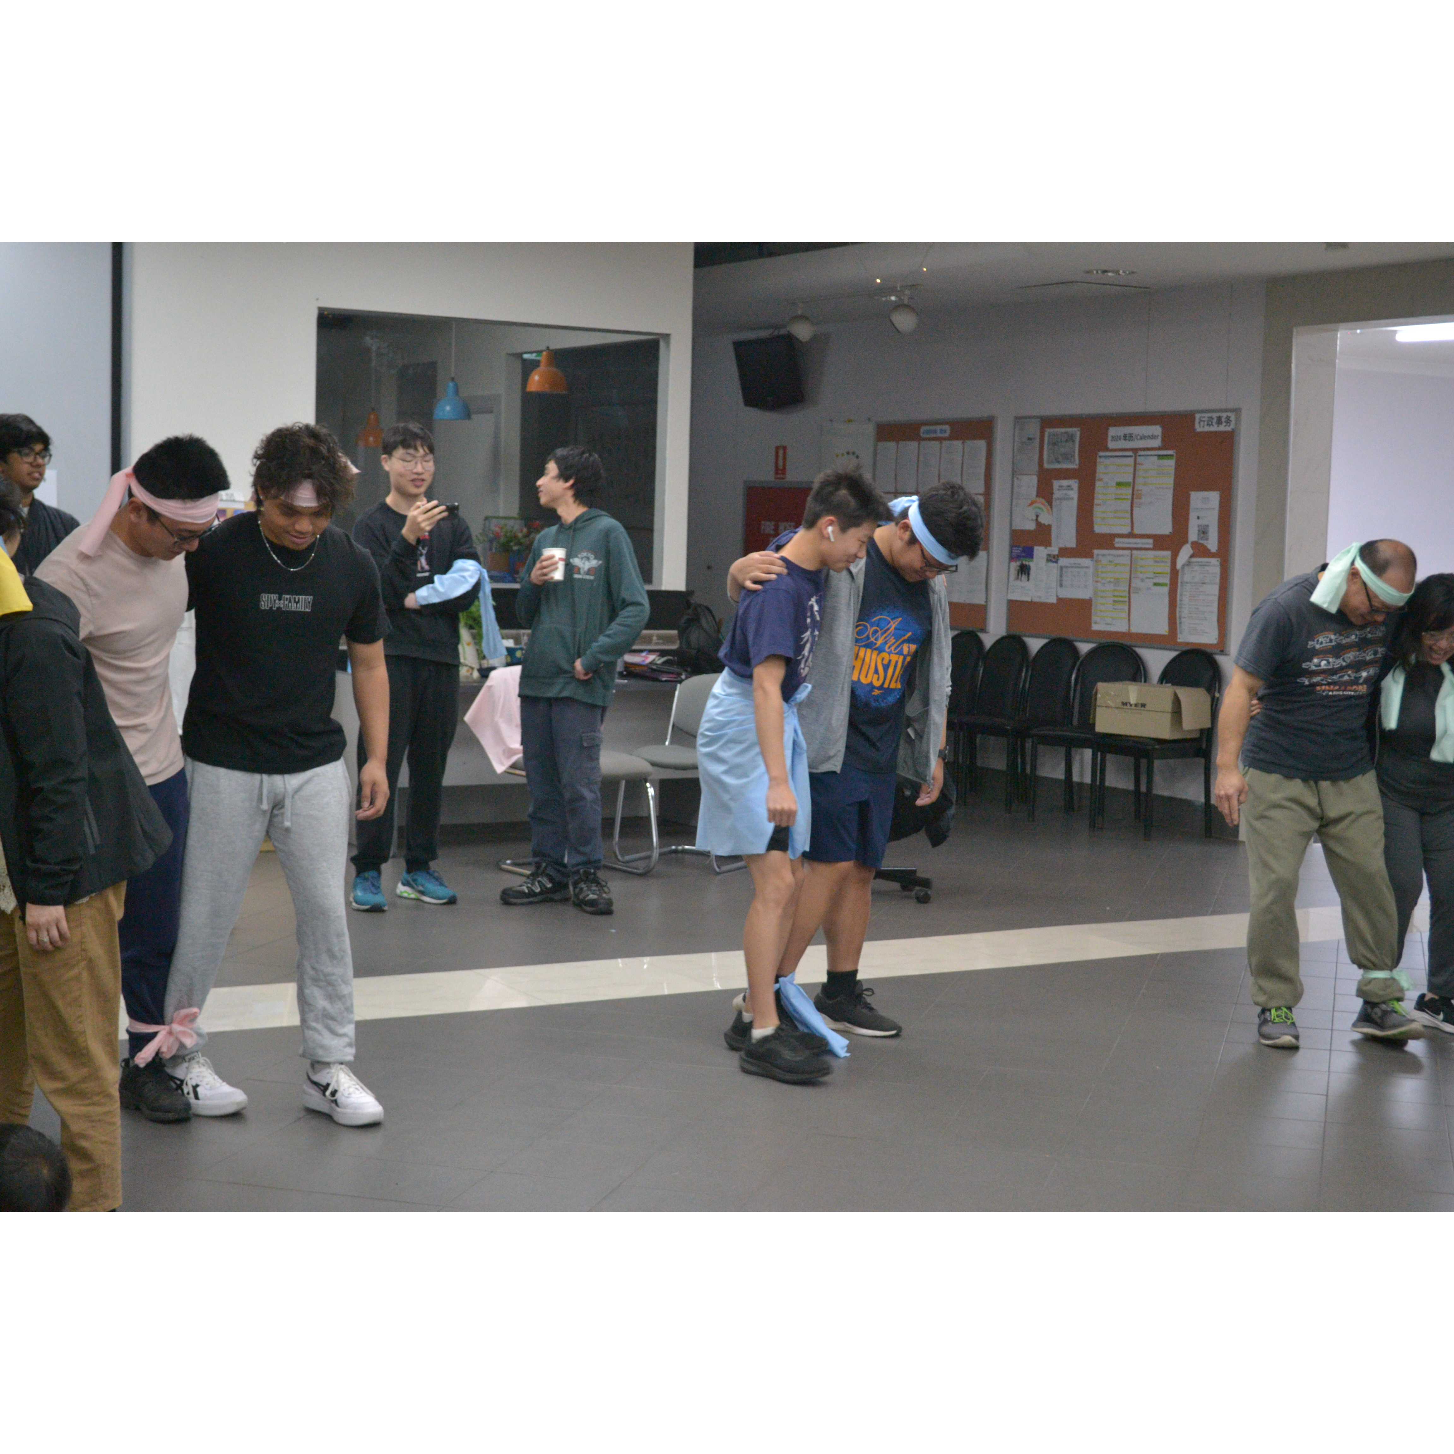
Mingle time!

